Slide 1

University Database
Gainelov Gani
Se-2017
Astana IT | Education Practice
2020

Slide 2

Content
Introduction
The progress
Diagram
Conclusion

Slide 3
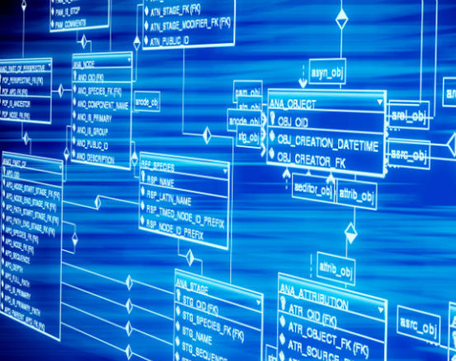
My practical task is to create a database for the university. More precisely, it is my task to create a university library and some more tables.

Slide 4

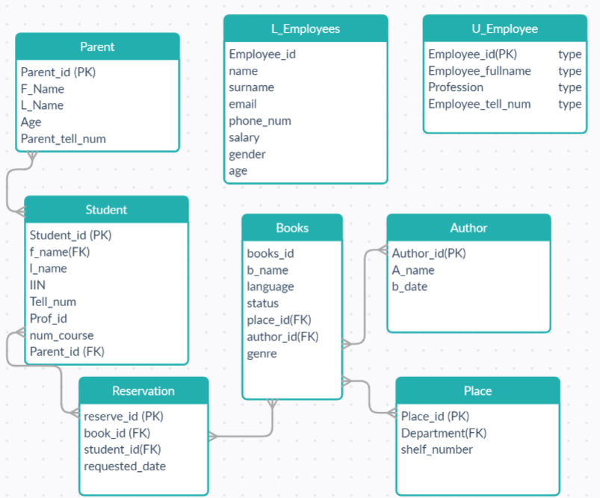
ERD Diagram
First, for more convenient work with the database, you need to create a diagram. As you can see, this is my diagram, and it contains 8 tables. Tables:

Slide 5
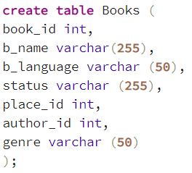
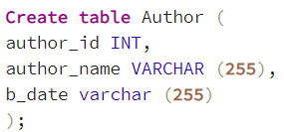
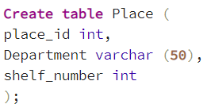



Progress
First, I created the tables. Then I added data to it.

Slide 6

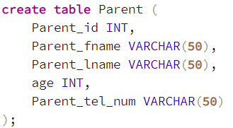
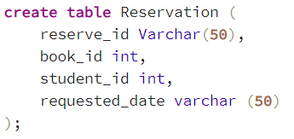
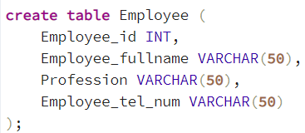
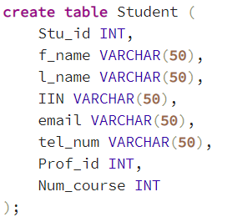


Progress
Here`s same.

Slide 7
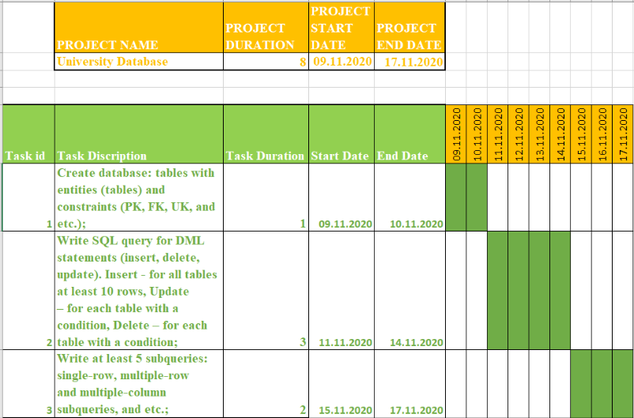
Diagram

Slide 8
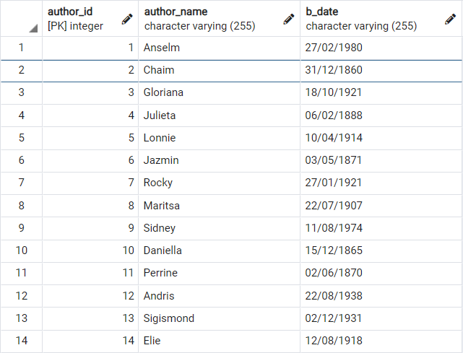
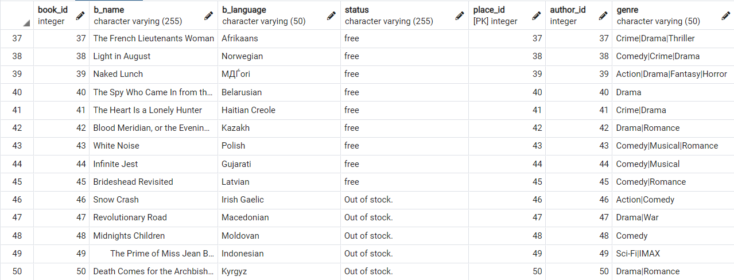
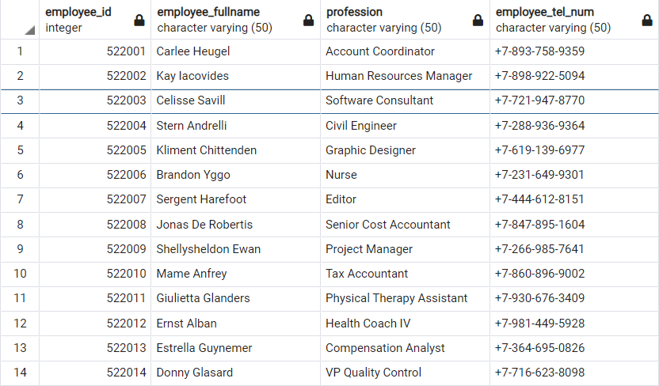
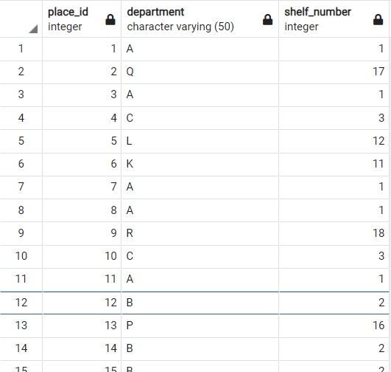

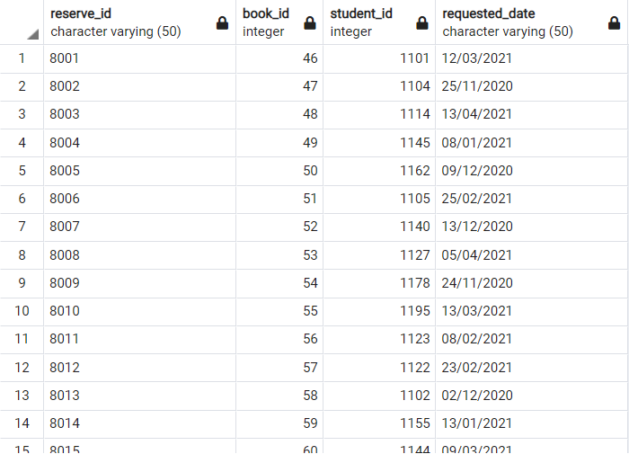
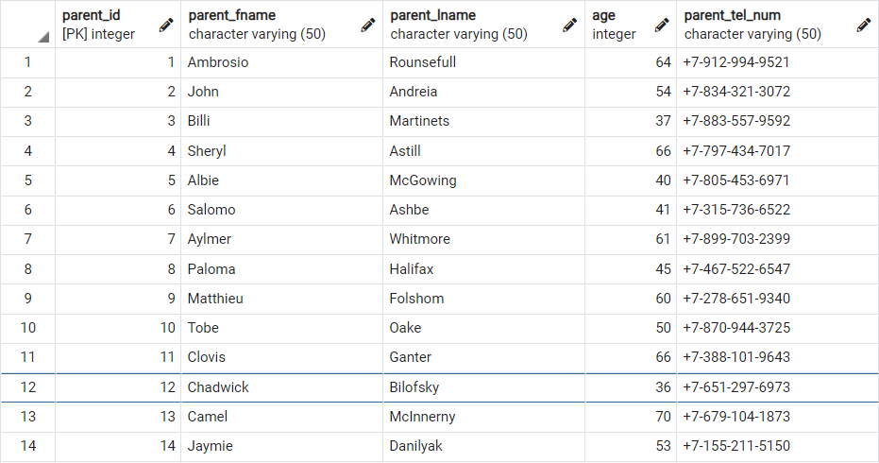


Slide 9
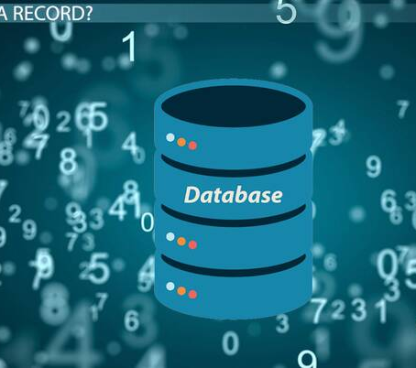
References
https://searchsqlserver.techtarget.com/
https://www.postgresql.org/
https://www.youtube.com/watch?v=00s5efQWrgU
https://www.youtube.com/watch?v=h5wgbJiSy7Q&t=6s

Slide 10

Thanks to your attention!

